Slide 1
PROBLEM SOLVING AND PROGRAMMING USING PYTHON
Mr.Panduraju Pagidimalla
Assistant Professor, Dept of AIML

Slide 2
Unit-I: Introduction to Python

Slide 3
Identifiers and keywords

Slide 4
Keywords
In Python programming, keywords are reserved words that hold a specific meaning and are a part of the language's syntax.

Slide 5
Rules for Keywords in Python
Reserved Use: Keywords have specific, predefined uses and cannot be altered.
Case Sensitivity: Python keywords are case-sensitive.
No Identifier Usage: Keywords cannot be used as variable names, function names, or other identifiers.
Fixed Number: The keywords are fixed and vary with Python versions.
Non-Modifiable: Keywords are part of Python's syntax and cannot be modified.
Syntax Compliance: Keywords must be used according to Python's syntax rules.

Slide 6
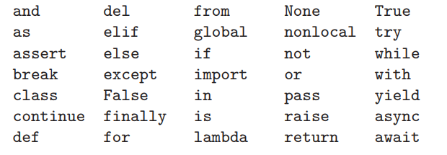
Keywords
Note: All keywords except None, True, and False are in lowercase

Slide 7
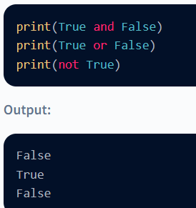
Example: and, or, not, True, False Keywords

Slide 8
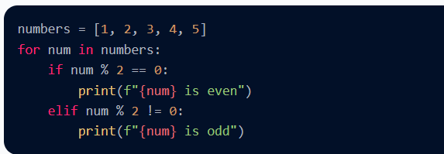
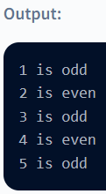
Example: for, in, if, elif Keywords

Slide 9
Identifiers
In programming languages, identifiers are names used to identify a variable, function, or other entities in a program

Slide 10
The rules for naming an identifier in Python
A name must start with a letter (uppercase or a lowercase alphabet) or the underscore (_) character
An identifier cannot start with a number
An identifier can only contain alpha-numeric characters and underscores (A-z, 0-9, and _ )
Variable names are case-sensitive (age, Age and AGE are three different variables)
A variable name cannot be any of the Python keywords.
We cannot use special symbols like !, @, #, $, %, etc., in identifiers.

Slide 11
Variables
A variable is a location in memory used to store some data (value).
They are given unique names to differentiate between different memory locations.
  The rules for writing a variable name is same as the rules for writing identifiers in Python.
In Python, we simply assign a value to a variable and it will exist.
We don't even have to declare the type of the variable.
  This is handled internally according to the type of value we assign to the variable.

Slide 12
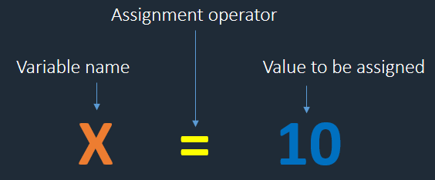

Slide 13
Example Variables
Variable assignment | Valid/Invalid
sal=23 | Valid
$sal=45 | Invalid
@name="python" | Invalid
-sal=45 | Invalid
456=3.4 | Invalid
_sal_=45 | Valid
_=56 | Valid
__=5.6 | Valid
--=45 | Invalid

Slide 14
Example Variables
Variable assignment | Valid/Invalid
tot sal=45 | Invalid
tot_marks=456 | Valid
tot#sal=56 | Invalid
Variable assignment | Valid/Invalid
if=45 | Invalid
else=67 | Invalid
if1=56 | Valid
_else=67 | Valid

Slide 15
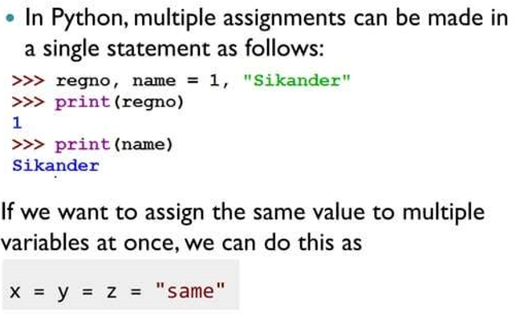
Multiple Assignments

Slide 16
THANK YOU !

